Slide 1
Artificial Intelligence And machine learning
Flat Price Prediction
Faculty Coordinator: Team Details:
Ms. Monica Dutta Naman Bassi
Nikhil Guleria
Arshad Malik
Harsh Panwar
:
Chitkara University Institute of Engineering and Technology,
Chitkara University, Punjab

Slide 2
CONTENTS
Problem Statement
Objective
EDA
Tools Used
Data Summary
Exploratory Data Analysis
Challenges
Recommendations
Conclusions
Result
Q & A

Slide 3
Problem Statement
The Flat Price Prediction EDA project aims to explore data attributes such as area, bedrooms, and furnishing status to understand factors affecting residential property prices.
By leveraging Exploratory Data Analysis techniques, it seeks to provide insights for buyers, sellers, and investors to make informed decisions in the dynamic real estate market.
This project ill be involving involves data preprocessing, feature engineering, and evaluating different regression algorithms

Slide 4
OBJECTIVE
Data Exploration: Conduct thorough analysis of the dataset to understand the distribution, trends, and relationships among various attributes affecting Flat prices. This project aims applying some amazing Python Libraries like as Plotty which will give a boost to our visual understanding of the data.
Feature Identification: Identify key features such as area, bedrooms, bathrooms, and furnishing status that have a significant impact on Flat prices.
Insight Generation: Use Exploratory Data Analysis techniques to uncover insights into the factors driving fluctuations in residential property prices.
Model Preparation: Prepare the dataset for predictive modeling by selecting relevant features, handling missing values, and encoding categorical variables..

Slide 5
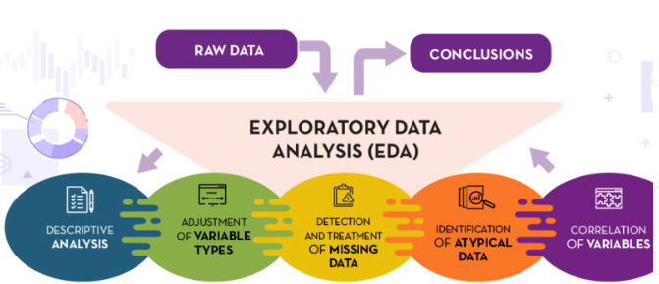
Exploratory Data Analysis
Exploratory Data Analysis (EDA) refers to the method of studying and exploring record sets to apprehend their predominant traits, discover patterns, locate outliers, and identify relationships between variables. EDA is normally carried out as a preliminary step before undertaking extra formal statistical analyses or modeling.

Slide 6
Tools used
VS code is used as IDE.
Pandas and NumPy are used for Data Manipulation & Pre-processing and Mathematical functions respectively.
Exploratory data analysis is automated by data prep.
For visualization of the plots, Matplotlib, Seaborn, Plotty are used.

Slide 7

Data Summary
Numerical Data
Price
Area
Bedrooms
Bathrooms
Stories
Parking
Categorical Data
1.Furnishing Status
2. Mainroad
3. Guest room
4. Basement
Hot waterHeating
Preferred Area
Airconditioning

Slide 8
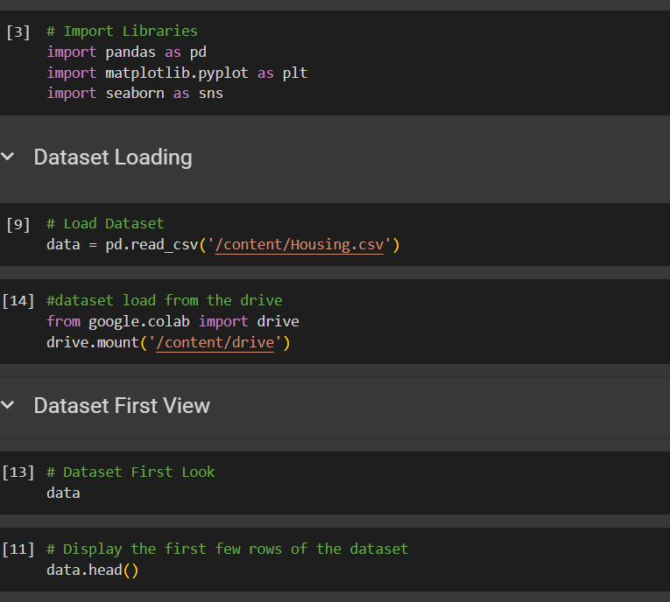
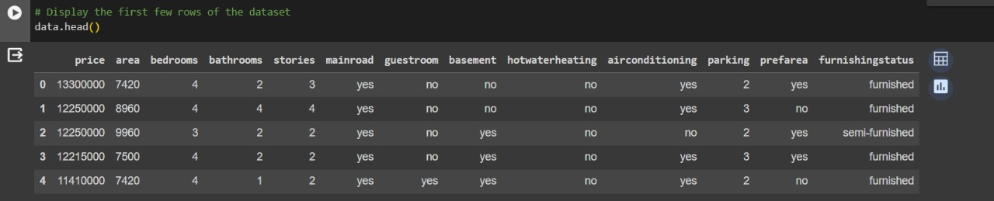
Data Summary
This is the Flat Price Predicting dataset. In the below table it shows the top 5 rows.

Slide 9
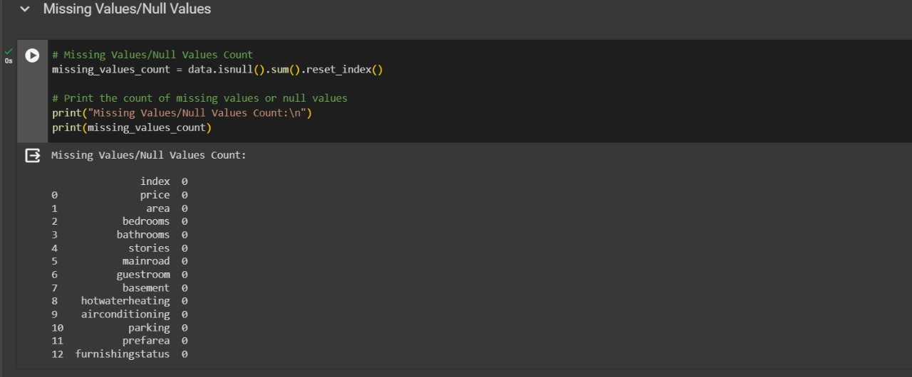
Data Summary
No column includes null or missing values

Slide 10
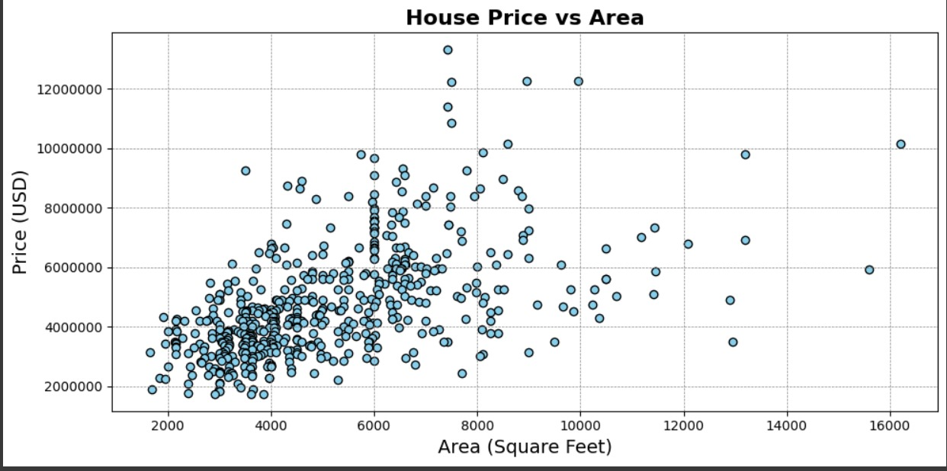
Analysis of the Flat Price based on Area
The scatter plot shows a positive correlation between Flat size and price, indicating that larger Flats tend to have higher prices.
Flats with area 6000 to 10000 square feet are averagely priced between 60to 80lakh

Slide 11
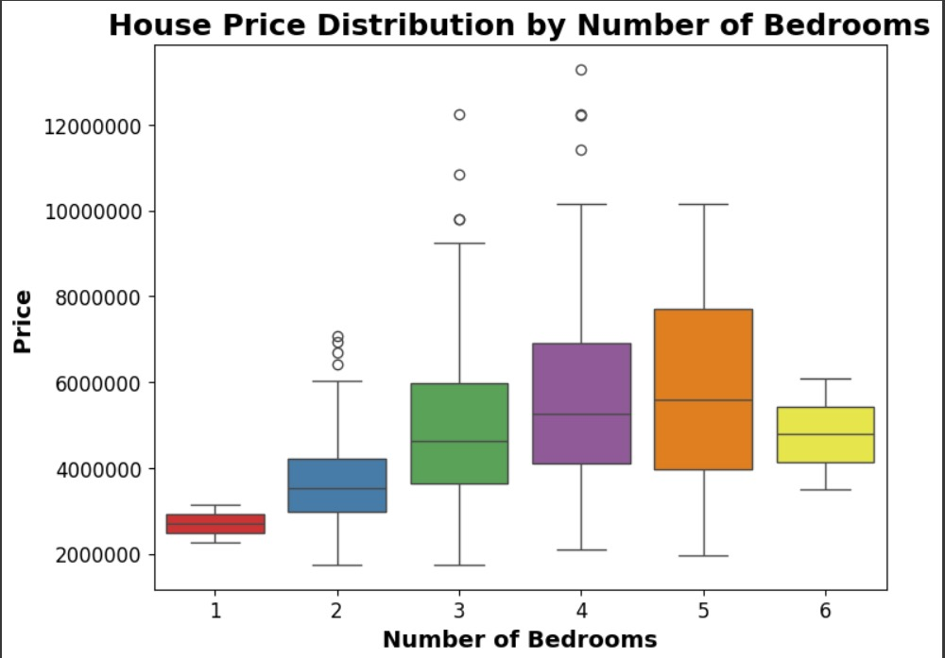
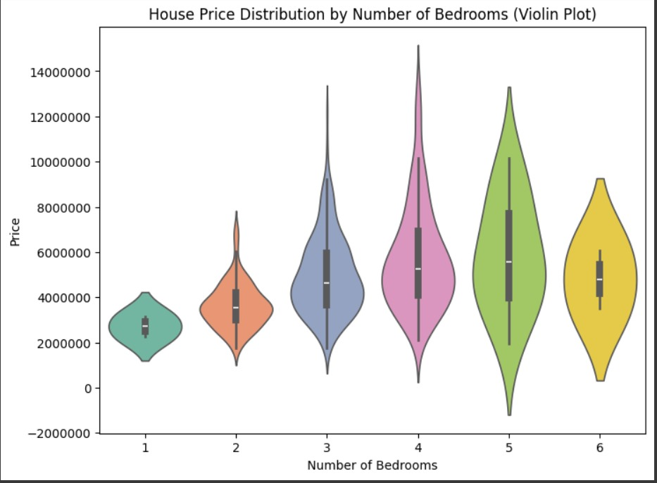
Analysis of Price by No of bedrooms
A box plot is selected to understand the distribution of Flat prices based on the number of bedrooms so that the outliers can be found.
Unlike a box plot that can only show summary statistics, violin plots depict summary statistics and the density of each variable.

Slide 12
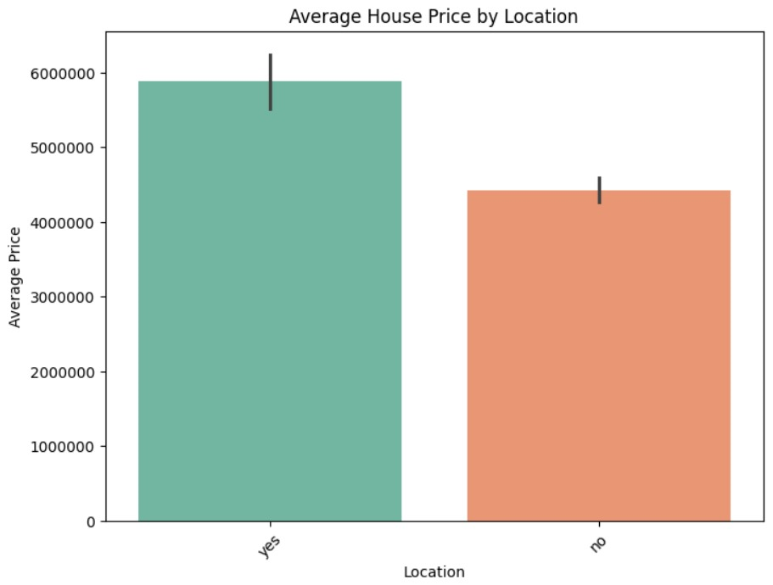
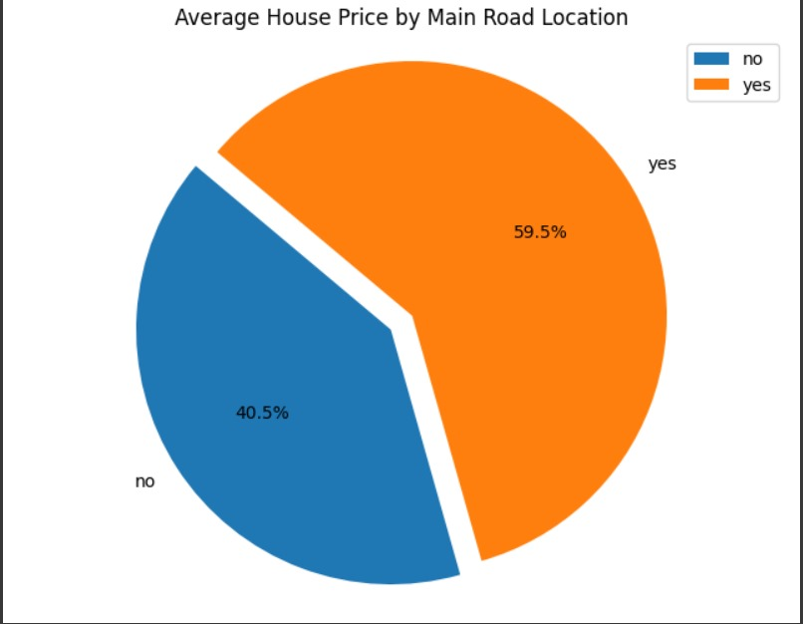
Analysis of Average Price by
Main Road Location
They provide a clear representation of the distribution of average prices between Flats located on the main road ('yes’) and those not located on the main road ('no'), aiding in comparison and analysis.

Slide 13
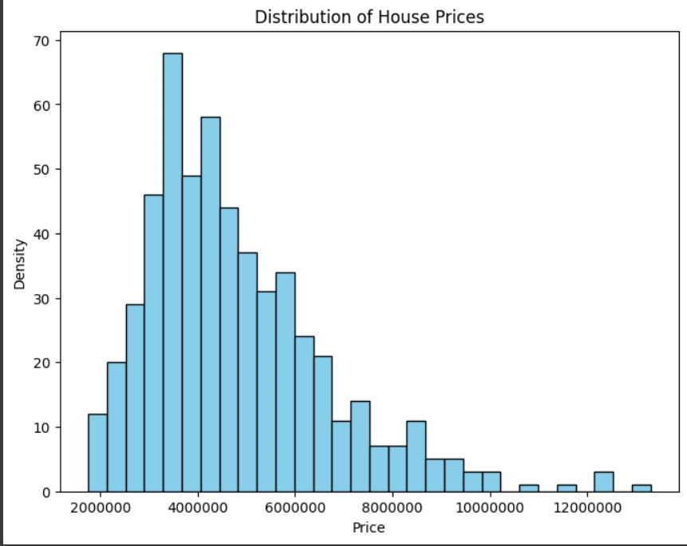
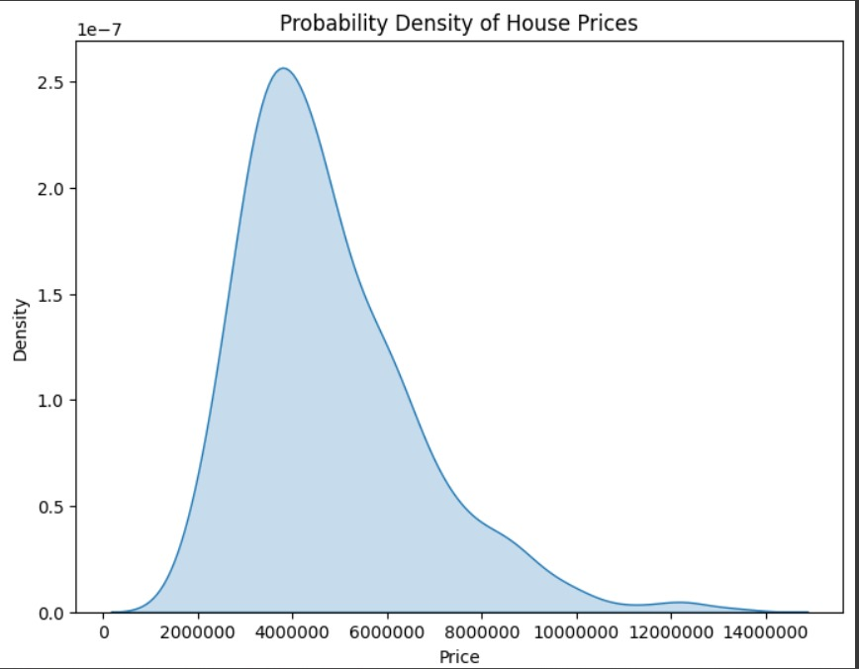
Analysis of Distribution Of Prices
Histograms effectively display the frequency distribution of continuous numerical data.

Slide 14
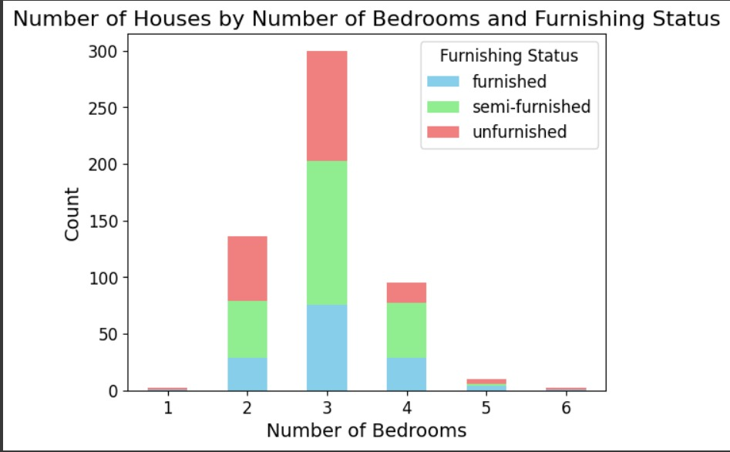
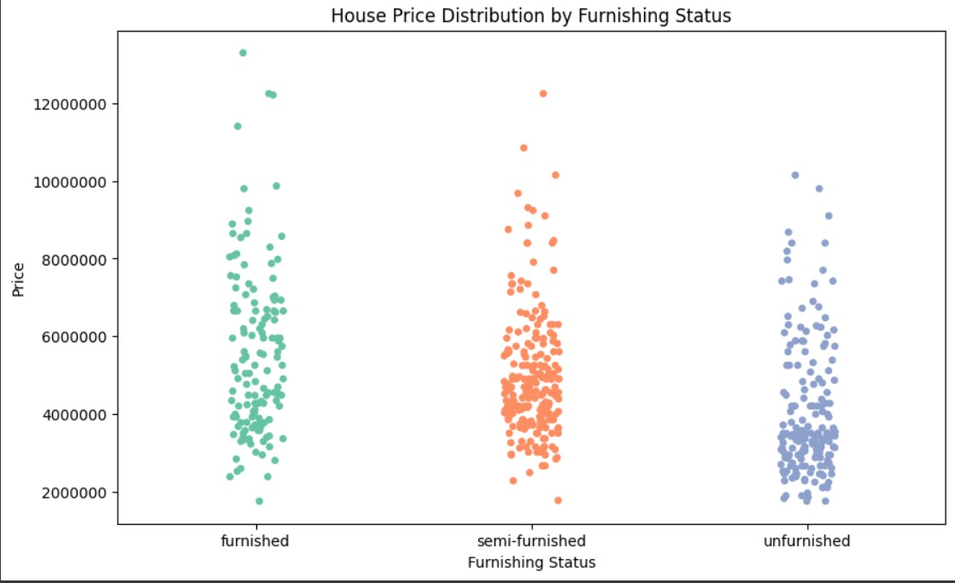
Analysis Based on Furnishing Status
Box Plot highlights the proportion of Flats with different furnishing statuses within each category of bedrooms.
A swarm plot was chosen to visualize the distribution of Flat prices across different furnishing statuses

Slide 15
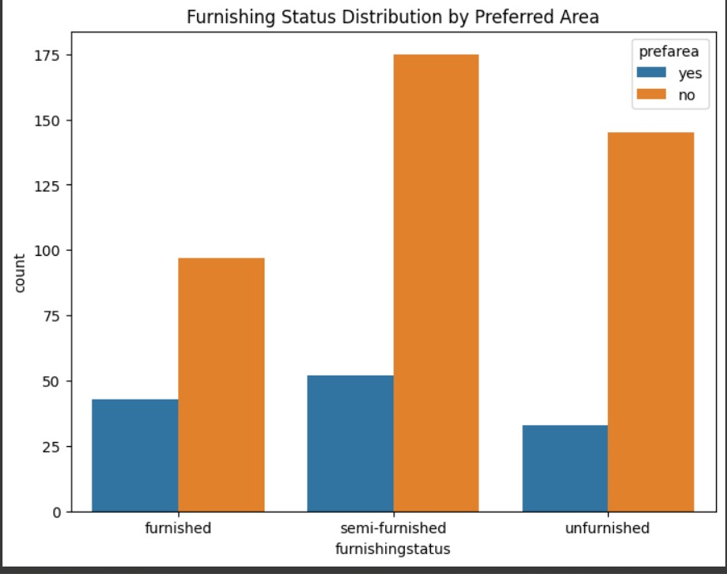
Distribution Of Flat by preferred area and furnishing status
The specific chart chosen, a countplot with hue, was likely selected because it effectively visualizes the distribution of furnishing status across different preferred areas. The countplot is suitable for showing the frequency of categorical variables

Slide 16
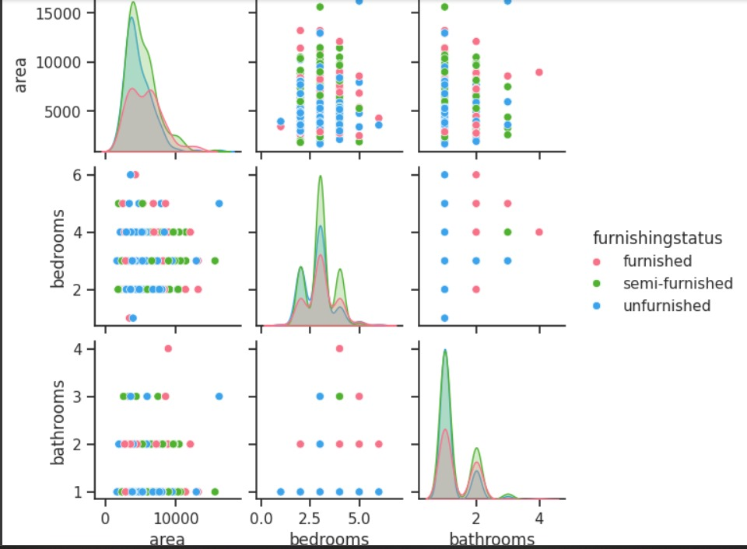
Distribution Of Flat by preferred area and furnishing status
Pair plot was selected for comprehensive visualization of pairwise relationships. Suitable for exploratory data analysis due to quick overview of correlations.

Slide 17
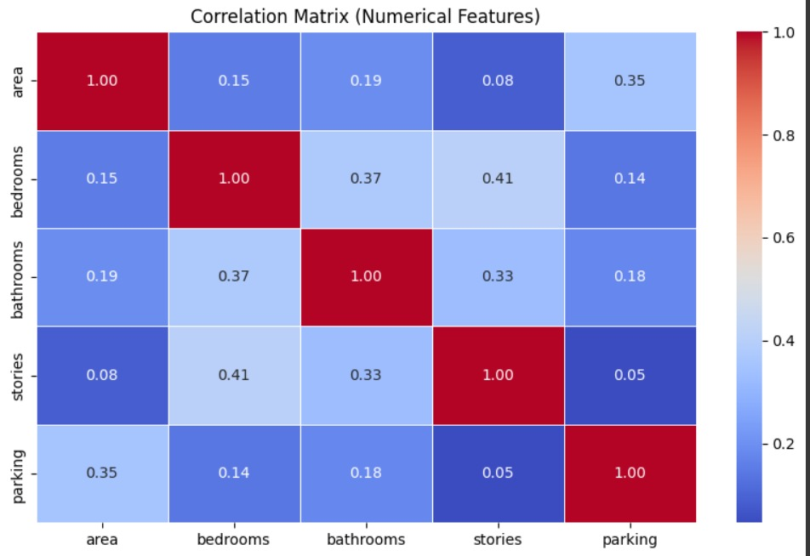
Correlation Matrix
Heatmaps are useful for cross-examining multivariate data, through placing variables in the rows and columns and coloring the cells within the table.

Slide 18
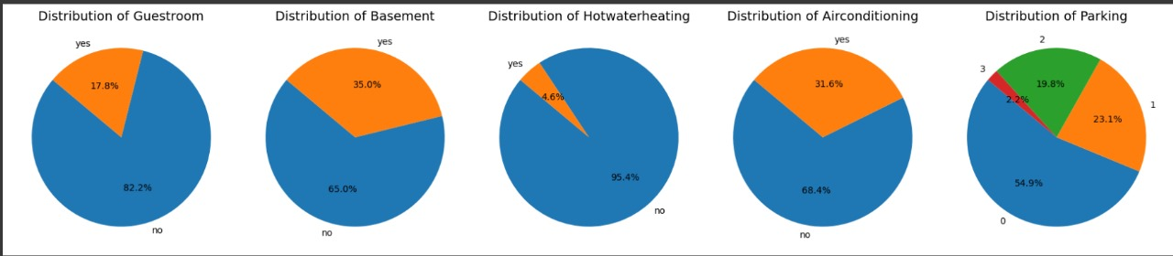
Pie Chart On various Columns
 | Yes | No
Guestroom | 17% | 82%
Basement | 35% | 65%
Hotwaterheating | 5% | 95%
Airconditiong | 31% | 68%

Slide 19
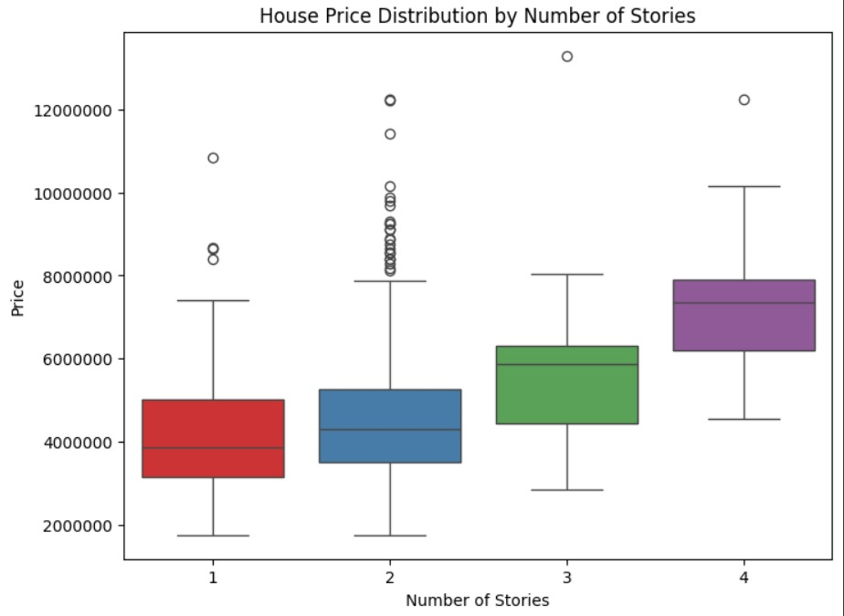
Flat Price Distribution By Number Of Stories
Box Plot highlights the proportion of Flats within each no of stories

Slide 20
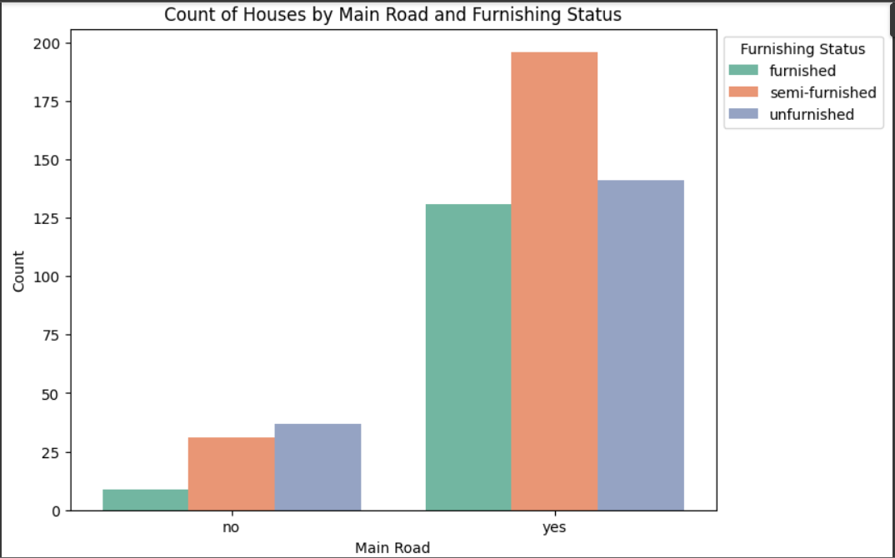
Flat Price Distribution By Number Of Stories
Bar plot depicts the count of Flats that are at main location with type of furnishing status

Slide 21
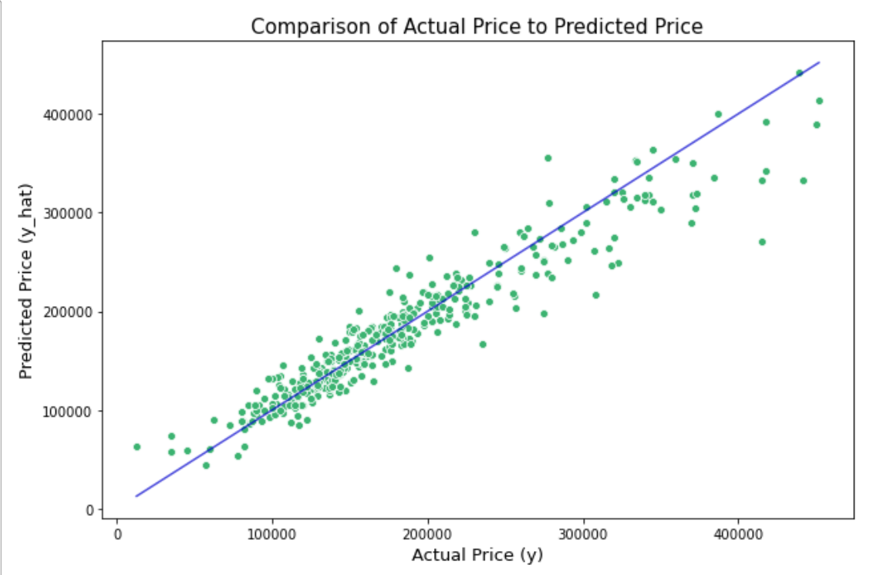
Linear Regression
Linear regression is defined as an algorithm that provides a linear relationship between an independent variable and a dependent variable to predict the outcome of future events.

Slide 22
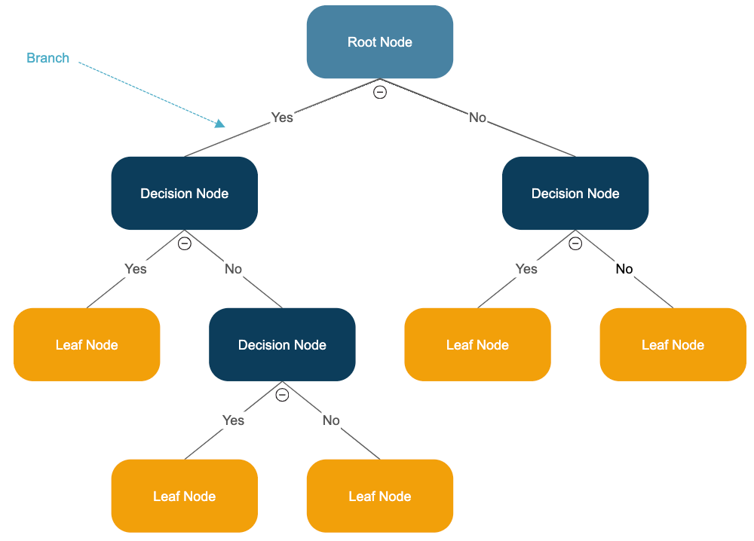
Decision Tree
A decision tree is a non-parametric supervised learning algorithm, which is utilized for both classification and regression tasks. It has a hierarchical, tree structure, which consists of a root node, branches, internal nodes and leaf nodes.

Slide 23
Result
Accuracy of linear regression is 75.57%
Accuracy of decision tree is 70.023%

Slide 24
Conclusion
In conclusion, This algorithm is to predict prices of newproperties that are going to be listed by taking some inputvariables and predicting the correct and justified price.Itwas a great learning experience building this predictiveSale Price model. In Future Using different methods thatmatch the time-series data will be used in the research toobtain smaller error prediction values and using more datato get the better result.

Slide 25


